Slide 1
Programming Fundamentals
By
Shazmeen Batool

Slide 2
Previous Lecture
for loop

Slide 3
Today’s Lecture
for loop continued

Slide 4
Class Activity
Vary the control variable from 1 to 100 in increments of 1.
Vary the control variable from 100 down to 1 in decrements of 1.
Vary the control variable from 7 to 77 in steps of 7.

Slide 5
Class Activity
Vary the control variable from 20 down to 2 in steps of -2.
Vary the control variable over the following sequence of values: 2, 5, 8, 11, 14, 17.
Vary the control variable over the following sequence of values: 99, 88, 77, 66, 55.

Slide 6
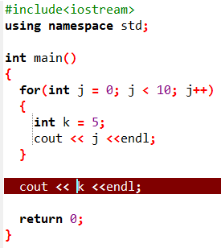
Errors
Variable Visibility

Slide 7
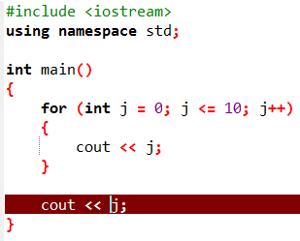
Errors
Variable Visibility
When a variable is defined in the initialization expression of a for loop, the scope of the variable is limited to the loop. This means you cannot access the variable in statements outside the loop.

Slide 8
Avoid Modifying the Counter Variable in the Body of the for Loop
Be careful not to place a statement that modifies the counter variable in the body of the for loop.
All modifications of the counter variable should take place in the update expression, which is automatically executed at the end of each iteration.
If a statement in the body of the loop also modifies the counter variable, the loop will probably not terminate when you expect it to.

Slide 9
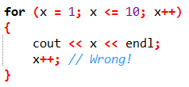
Avoid Modifying the Counter Variable in the Body of the for Loop
The following loop, for example, increments x twice for each iteration:

Slide 10
Using Multiple Statements in the Initialization and Update Expressions
It is possible to execute more than one statement in the initialization expression and the update expression.
When using multiple statements in either of these expressions, simply separate the statements with commas.

Slide 11
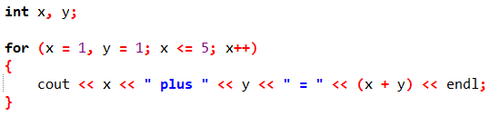
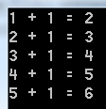
Using Multiple Statements in the Initialization and Update Expressions

Slide 12
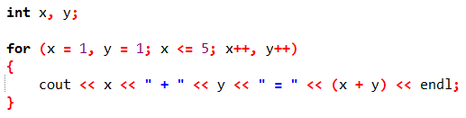
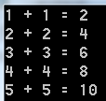
Using Multiple Statements in the Initialization and Update Expressions

Slide 13
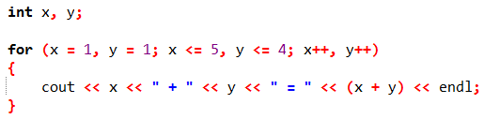

Using Multiple Statements in the Initialization and Update Expressions

Slide 14
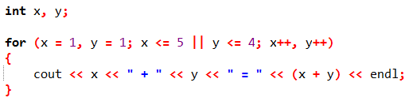
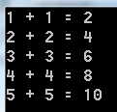
Using Multiple Statements in the Initialization and Update Expressions

Slide 15
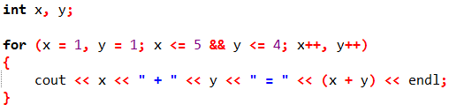

Using Multiple Statements in the Initialization and Update Expressions

Slide 16
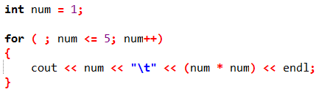
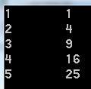
Omitting the for Loop’s Expressions
The initialization expression may be omitted from inside the for loop’s parentheses if it has already been performed or no initialization is needed.

Slide 17
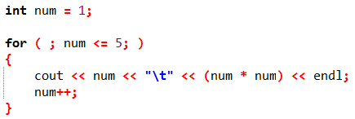
Omitting the for Loop’s Expressions
You may also omit the update expression if it is being performed elsewhere in the loop or if none is needed.
Although this type of code is not recommended, the following for loop works just like a while loop:

Slide 18

Omitting the for Loop’s Expressions
You can even go so far as to omit all three expressions from the for loop’s parentheses. Be warned, however, that if you leave out the test expression, the loop has no built-in way of terminating.

